Slide 1
DS530 Week 4

Slide 2
Week | Objective | Assignment Deadlines
1/18/24 | Introduction to Big Data and Data Engineering
1/25/24 | Big Data and Data Engineering Cont.
2/1/24 | Data Warehouse vs. Data Lakes | Read Chapters 1-2
2/8/224 | Hadoop and MapReduce | Read Chapter 3
2/15/24 | Intro to Snowflake | Read Chapter 4
2/22/24 | Snowflake Cont. | Complete Data Warehouse Badge

Slide 3







Modern Data Stack
Ingestion
Data Storage
Data Source
Data
Transformation
Data Analysis

Slide 4
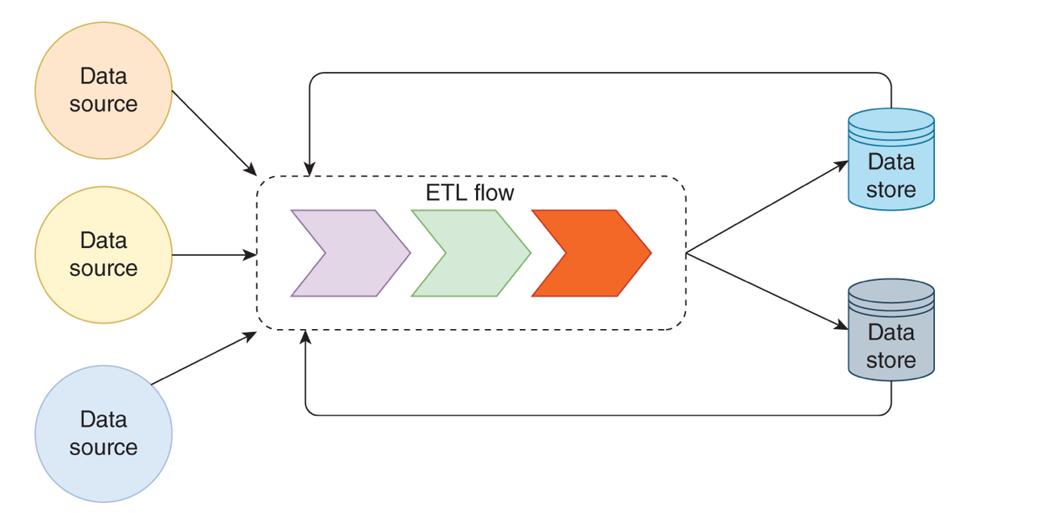
Offline Big Data Processing
Notes:
Important part is capacity of the system rather than latency

Slide 5
ETL
Extract
Retrieve and collect data from source system
May require DB connection, connect to a messaging system
Transform
Executing steps of business rules to convert source format to destination formation (e.g. convert date time, height from metric to feet …)
Load

Slide 6
Brief Review of Nodes and Node Clusters

Slide 7
Nodes and Clusters
Node
Servers that holds the data
Basic unit of data structure
Can be linked or in a tree structure
Cluster – A collection of Nodes
Block – Each File

Slide 8
Node Examples
Decision Tree
(Leaf Nodes)
Linked List

Slide 9
Hadoop

Slide 10
History of Hadoop
Google Released Google File System Paper
Nutch Distributed File System was introduced
2002
2003
2004
2005
2006
Apache Nutch Started
Google Released paper on MapReduce
Hadoop was introduced with HDFS

Slide 11
On-premise Storage Solution
Deploying the platform to the company's data center, where the organization invest in hardware, maintenance, and talent.
Disadvantage: up-front cost
Advantage: cost less over long term
Ideal for organization which has a data center already

Slide 12
HDFS Architecture

Slide 13
HDFS
Hadoop Distributed File System (HDFS) – de facto storage system for on-premise big data platform
Easy to use commodity hardware (built to to handle hardware failure)
Fault tolerate – replicate data among nodes
Need to consider other aspects – deployment, capacity planning, monitoring and hiring
Sequential Access of the File
Whole Data only
Appending the files is possible

Slide 14
HDFS Cluster
Data Node
Data Node
Block
Block
Block
Block
NameNode
Data node
Data Node
Block
Block

Slide 15


Slide 16
Choosing Hardware
Hadoop clusters consist of the following types of nodes:
NameNodes
job trackers
DataNodes
Application nodes (Hive Metastore)
DataNodes
Use for storage and MapReduce job
Use JBOD (just a bunch of disks) – decrease the cost. Disk failure is handled by Hadoop internally
Computation is done on these nodes – closer to the data

Slide 17
Choosing Hardware (cont.)
NameNodes
Critical component in the cluster
Single point of failure
Contain information about file system, know the list data block and their location
Require a lot of memory – the data is stored in memory
Achieve high availability – more than one NameNode
Use Apache Zookeeper to handle automatic failover
lightweight. Can be collocated with the Resource Manager
Notes:
ZooKeeper is
open-source server for highly reliable distributed coordination of cloud applications
essentially a service for distributed systems offering a hierarchical key-value store, which is used to provide a distributed configuration service, synchronization service, and naming registry for large distributed systems
A subproject of Hadoop

Slide 18
Choosing Hardware (cont.)
Resource Managers
Track resources and schedule applications
Doesn’t need a lot of memory, but need compute power
Constant negotiate resources with applications, track resources, communicate with node managers in DataNodes
Can configure active and standby Resource Managers
Use Apache Zookeeper for automatic failover
Zookeeper – lightweight. Can be collocated with the Resource Manager

Slide 19
Network Equipment
Use network to
transfer files to DataNodes and MapReduce jobs
Get status updates from Nodes

Slide 20
Capacity Planning
What is the volume of ingested data for daily, weekly, and monthly?
Increase of overall data can be predicted by looking at the trends
What is the rate of data accumulation? Does it change a lot?
Think about the volume
How many tasks each node is supposed to execute?
Think about the variety
Retention- How much data to keep around
3 years, 5 years? Which data

Slide 21
Hadoop Benefits and Weaknesses
Open Source from Apache Hadoop
Benefit
Can store any format from your resources
Weakness
Modifications are not possible
Delete and reupload
HDFS
Sequential Access of the File
Whole Data only
Appending the files are possible

Slide 22
HDFS Architecture
The File System Namespace
The certain location in the HDFS
Maintains the files system tree
All metadata of each file

Slide 23
HFDS FAILURES
NameNode
DataNode
Network Partitions

Slide 24
NameNode Failure
The Hadoop File System to DataNodes is a one to many relationship
If the NameNode goes down:
The whole cluster relating to that NameNode will be inactive
Cannot Upload/Delete from that specific cluster

Slide 25
DataNode Failure
Upon Failure:
The NameNode will reactivate the replication process on each block of the DataNode to Reactivate it

Slide 26
Network Partition Failure
Occurs when a subset of Nodes within a cluster is down
This causes a communication error within the server as the NameSpace can’t tell if the DataNode is alive or dead.
All actions will freeze as no further processing will occur

Slide 27
Data Disk Failure
DataNodes sends a signal to the NameSpace
Network partition error can cause subsets to lose connectivity disrupting the signal
If there is no signal the NameNode will no long make any requests to the DataNode

Slide 28
Presto
a distributed SQL query engine
supports various use cases such as ad hoc querying, reporting, and multi‐hour ETL jobs
can run against data sources from gigabytes to petabytes.
Connector API – integrate Hadoop Distributed File System (HDFS), RDMS, NoSQL and stream processing
query data on different data sources and return the results to caller

Slide 29
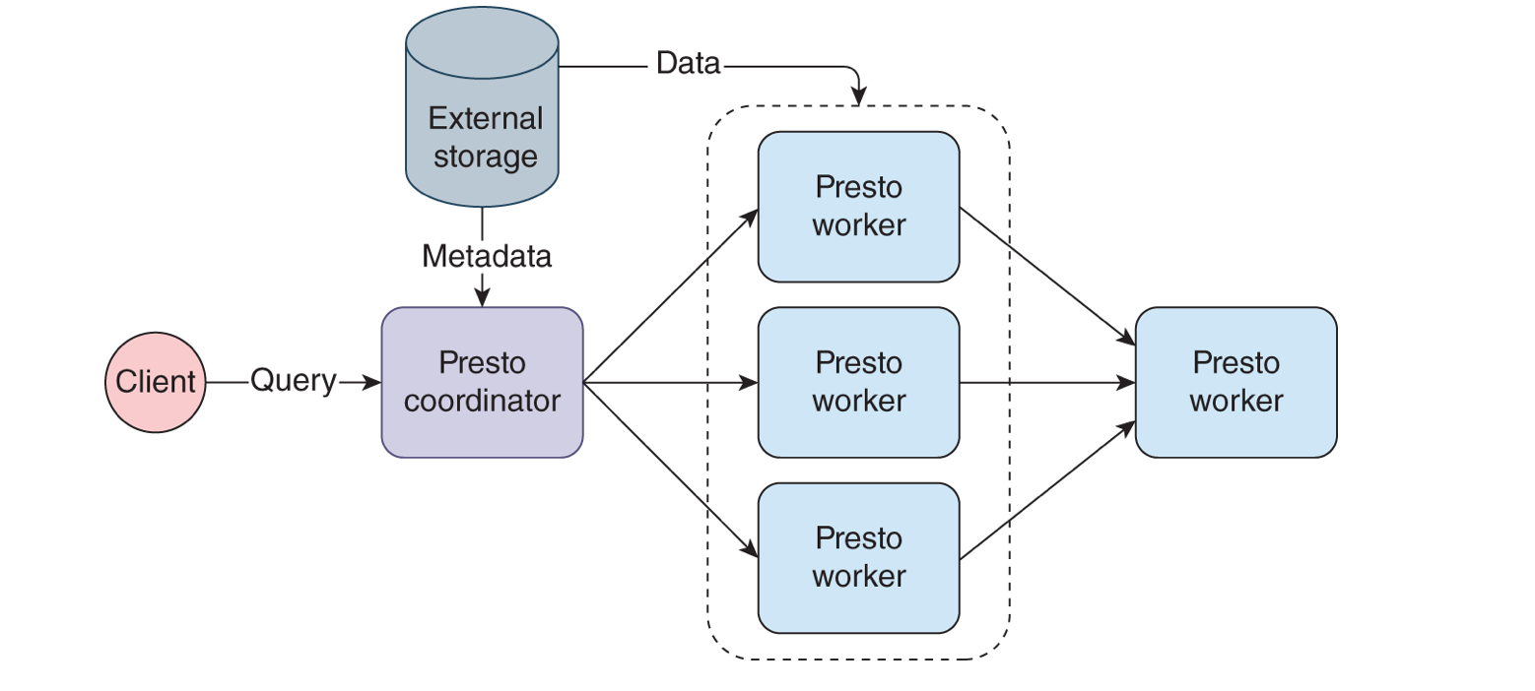
Presto architecture
Notes:
2 types of nodes – coordinator and >=1 worker
Coordinators accept the queries, parse them, plan and optimize the execution, and orchestrate the queries
Workers are responsible for query execution
Query comes in
coordinator uses Metadata API to get relevant information from the external storage system
coordinator locates the data through Data Location API and schedules tasks.
workers fetch the data through Data Source API and run relevant logic on the data.
the result is returned through the Data Sink API.

Slide 30
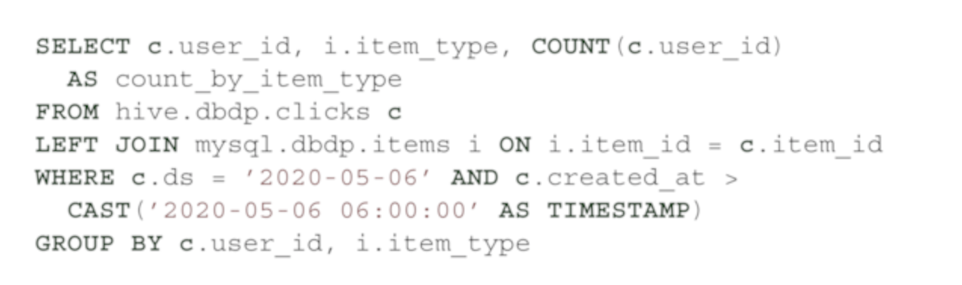
Presto - scheduling
Coordinator disseminates execution plan to workers as task
Execution plan – generated as a result of query
Notes:
Presto has two connectors: Hive and MySQL, referenced as hive and mysql,
Upon receiving the query, Presto plans an execution, schedules tasks, and manages resources.

Slide 31
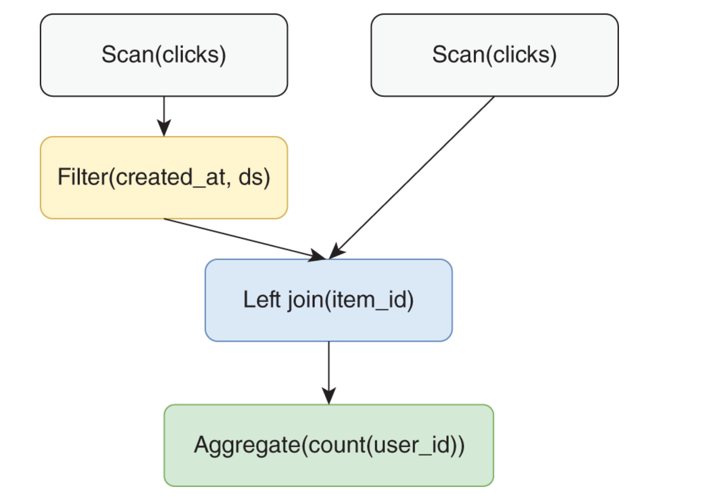
Presto – execution plan
Presto parses the query
Generate a logical plan
Distribute the plan as task to workers
Notes:
Preso has built in optimizer and scheduler

Slide 32
Presto - Scheduling
Disseminates execution plan to the works as task
Each Task would be initiated in a sequential order
If a task/worker fails, the process will stop

Slide 33
Yarn
Apache Yarn
Yet Another Resource Negotiator
Removes the bottleneck of Job Tracker from the first version of Hadoop
Splits the Resource Manager from the Processing Manager in ETL

Slide 34
MapReduce

Slide 35
MapReduce History
Google created MapReduce in 2004
Created due to the initial network overload that was occurring from the large volume of data being ingested through its servers
ETL Process was very slow
Built on Hadoop

Slide 36
MapReduce Defined
Map
The procedure the filtering and sorting
Reduce
Performing the summary actions
Count
Avg

Slide 37
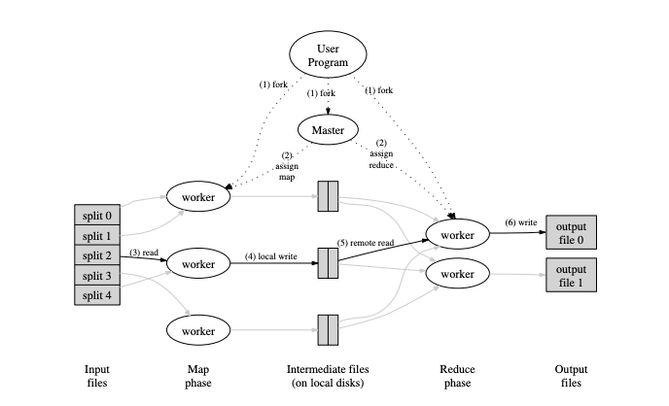
MapReduce Architecture
https://static.googleusercontent.com/media/research.google.com/en//archive/mapreduce-osdi04.pdf

Slide 38
MapReduce Architecture
User is responsible for the creation of the Master – creates the program that defines and assigns specific task to each worker
Master will assign jobs to each Worker
Worker runs specific calculations
MAP Worker
Reduce Worker

Slide 39
Worker Failure
MapReduce can handle worker failures on a server level
The Master will re-execute the job with a different worker server that is currently idle
After each task is completed
The worker that completed the task goes idle until the Master pings the server

Slide 40
What if Master Fails
The Master has a copy of itself that remains idle in the background
In the event of a master failure
Copy Master will activate restarting each worker task

Slide 41
Technologies to process big data
MapReduce - Require strong Java and programming model
Other technologies - built on top Google MapReduce frameworks
Apache Pig
Apache Hive
Apache Flink
Presto

Slide 42
Apache Pig
Developed by Yahoo as a research project to create and execute MapReduce jobs on dataset
First release in 2008
platform to analyze large sets of data represented as data flows.
provides a high‐level language Pig Latin to write data analysis programs
Pig Latin offers functionalities for reading, writing, and processing data.
Pig Latin are mapped to MapReduce task

Slide 43
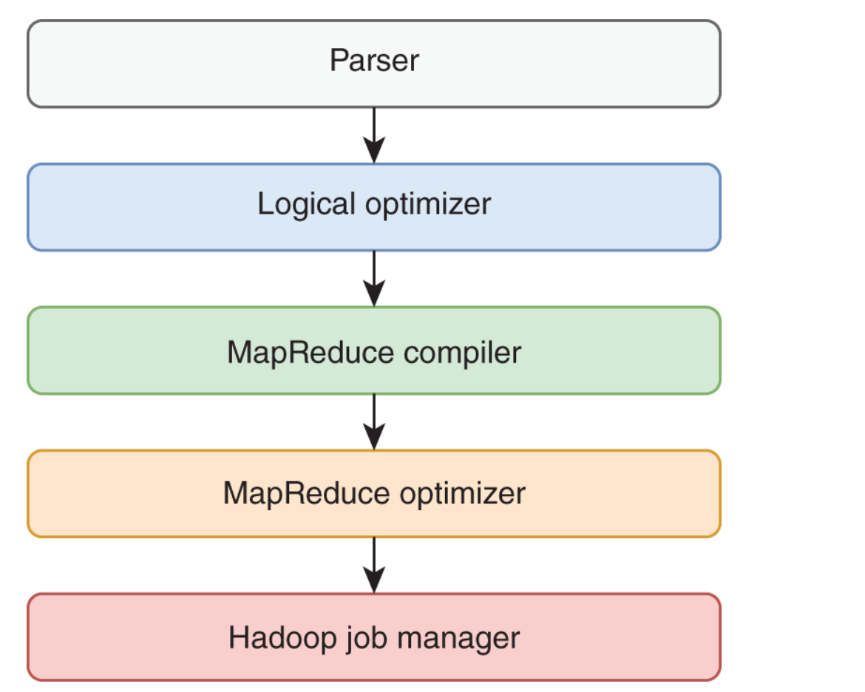
Apache Pig (cont.)
Input: Pig Latin program
Engine:
parse the program
optimized parsed program
compiles it one or more MapReduce jobs
Coordinates jobs on a Hadoop cluster

Slide 44
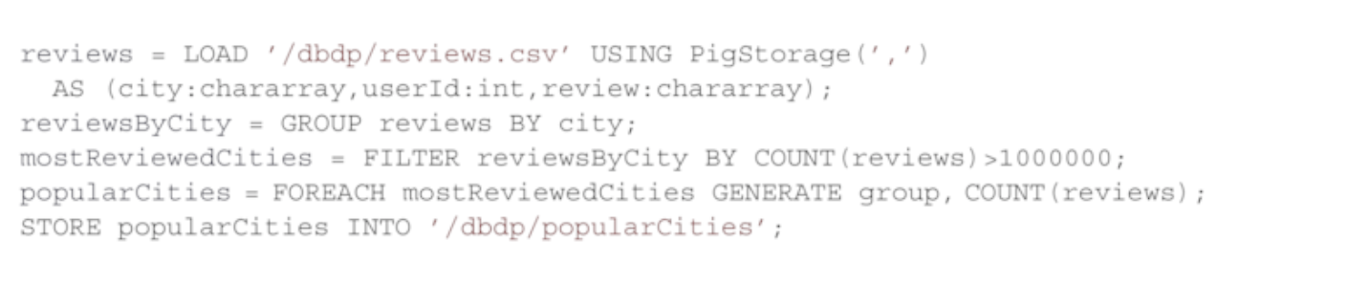
Apache Pig (cont.)
A data flow language
Each step defines the transformation
Start with LOAD, end with STORE commands

Slide 45
Apache Hive
Implemented over Hadoop to reduce the amount of effort for writing code.
uses a declarative language, Hive Query Language (HiveQL or HQL
similar to SQL, to ease the development of data processing
makes it straightforward for business analysts or data scientists to play with Big Data through ad hoc querying or scheduling
Notes:
https://hive.apache.org

Slide 46
Apache Hive- Hive Database
Models the data
Hive query language
Hive organizes data into
Tables, partitions and buckets
Hive stores metadata (information about the table, directory where the table is saved) in the system catalog
Tables may be date partitioned e.g. /dbdp/examples/ds=2020-03-13, /dbdp/examples/ds=2020-03-14…
Bucket may contain a hash of a column (i.e. the column)

Slide 47
Apache Hive – query language
Similar to SQL – joins, aggregates, unions ..
Support data definition language (DDL) statements to create tables, table partitioning and bucketing
Notes:
selects column 'foo' from all rows of partition ds=2008-08-15 of the invites table. The results are not stored anywhere, but are displayed on the console.

Slide 48
Reference
Hadoop
https://hadoop.apache.org/docs/stable/hadoop-project-dist/hadoop-hdfs/HdfsDesign.html
MapReduce
https://static.googleusercontent.com/media/research.google.com/en//archive/mapreduce-osdi04.pdf

